Slide 1
Web Development Framework Using Python (24CAI1105)
Team Details:
Khushboo - 2410993045
Ishleen Kaur - 2410993197
Liza Singla - 2410993056
Gurleen Kaur - 2410993030
Faculty Coordinator:
Dr. Gagandeep
:
Chitkara University Institute of Engineering and Technology,
Chitkara University, Punjab

Slide 2
Table of Contents
Introduction
Problem Statement
Technical Details
Key Features
Project Highlights
Bonus Feature(optional)
Conclusion
References/Links used

Slide 3
Introduction
INVENTORY MANAGEMENT SYSTEM
TEAM MEMBERS :-
Khushboo (Leader) - 2410993045
Ishleen Kaur – 2410993197
Liza Singla – 2410993056
Gurleen Kaur – 2410993030
Goal :- The main goal of this system is to efficiently automate and optimize the process of tracking, updating, and managing inventory with the ultimate goal of reducing costs and improving operational efficiency.

Slide 4
Problem Statement
Aim :- The aim of this is to streamline inventory management, reduce manual effort, and improve the accuracy and efficiency of inventory tracking, ensuring that businesses can maintain optimal stock levels and respond quickly to changing market demands. The system also offers advanced reporting tools, helping businesses track trends and make informed decisions on restocking and discontinuing products. With automated alerts and notifications, businesses can proactively manage stock levels and prevent disruptions in the supply chain.
Some research for this project is done from various web development tutoring sites and channels.

Slide 5
Technical Details
LANGUAGES USED :-
HTML: HTML forms the structural skeletal of webpages.
CSS: CSS is used to style the inventory system’s interface.
JavaScript: JavaScript adds interactivity to the inventory system, allowing for dynamic updates and form validation.
FRAMEWORKS USED :-
Django: Django is used as the backend framework to handle user requests, process data and generate the content displayed on the website.
Bootstrap: Bootstrap helps create a responsive and user-friendly design for the inventory management system, offering pre-designed components.

Slide 6
Application Modules
1. Accounts Application
Engineered a robust user authentication and authorization module enabling secure registration, login, and session management functionalities.
Incorporated advanced access control mechanisms, ensuring user-role segregation and data confidentiality.
2. Main Application
Devised an intelligent core system for warehouse orchestration, inventory lifecycle oversight, and real-time order fulfillment.
Seamlessly integrated barcode scanning capabilities to expedite inventory validation and streamline stock transactions.

Slide 7
Application Modules
Employed asynchronous data processing to enhance responsiveness and minimize operational latency.
3. Secondary Application
Constructed a dynamic frontend ecosystem encompassing feature listings, solution overviews, pricing structures, client portfolios, integrations, analytical reports, and other auxiliary interfaces.
Ensured consistent UI/UX paradigms across static content pages using reusable templates and Django's templating engine.
“It is a tri-modular Django-based system unifying secure user authentication, intelligent warehouse, inventory automation & a dynamic suite of static and analytical interfaces for end-to-end inventory management.”

Slide 8
Key Features
Order Management: Tracks incoming and outgoing orders, ensuring accurate records of sales and purchases. It also integrates with payment systems, allowing for seamless processing and reconciliation of financial transactions related to orders.
Supplier Management: Maintains detailed information on suppliers, including contact details, order history, and lead times. The system can also send automated reminders for reordering and track the performance of suppliers based on delivery timelines and quality.
Mobile Accessibility: Provides access to the inventory system through mobile devices, enabling on-the-go management. Users can also receive push notifications for important updates, such as low stock alerts or new order requests, directly on their mobile devices.
User Roles & Access Control: Provides secure access to the system by defining user roles, ensuring that only authorized personnel can perform specific tasks. Customizable permissions can be set for each role, ensuring users only have access to the tools and data.

Slide 9
Project Highlights
Upcoming slides include the relevant screenshots of our running project.

Slide 10
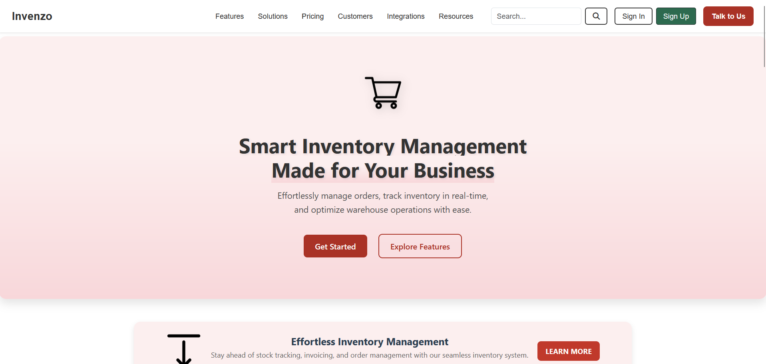
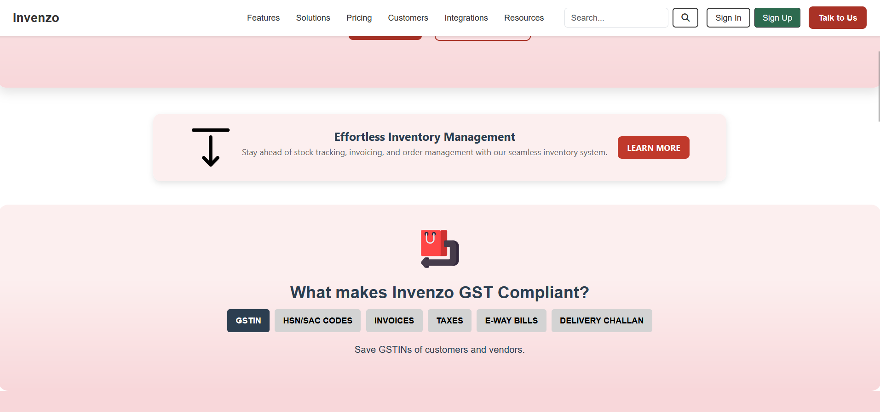
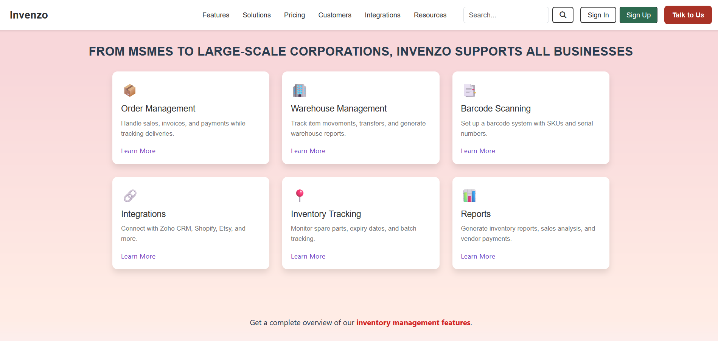
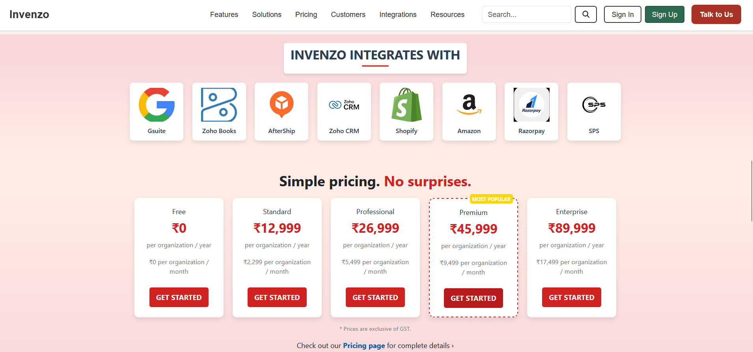
Project Highlights

Slide 11
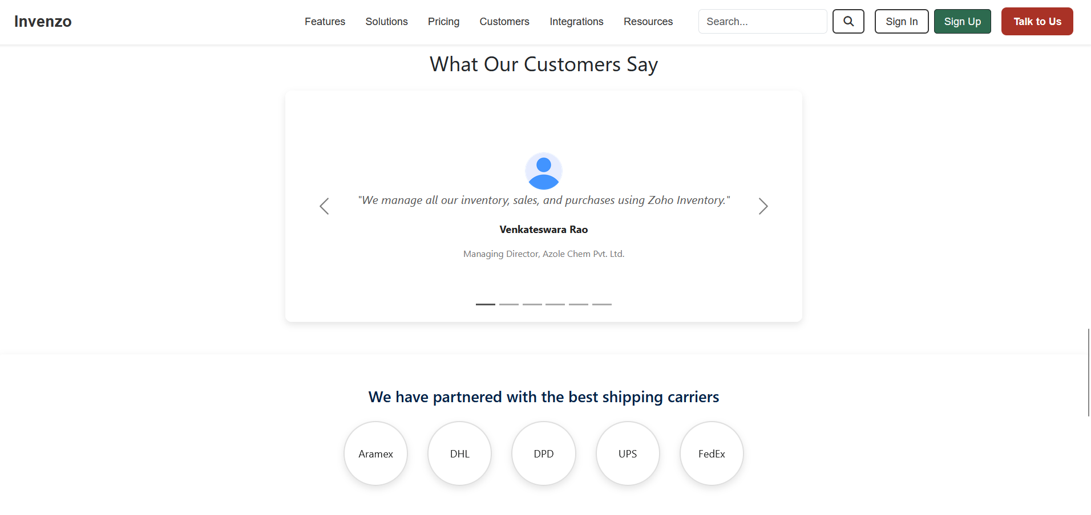
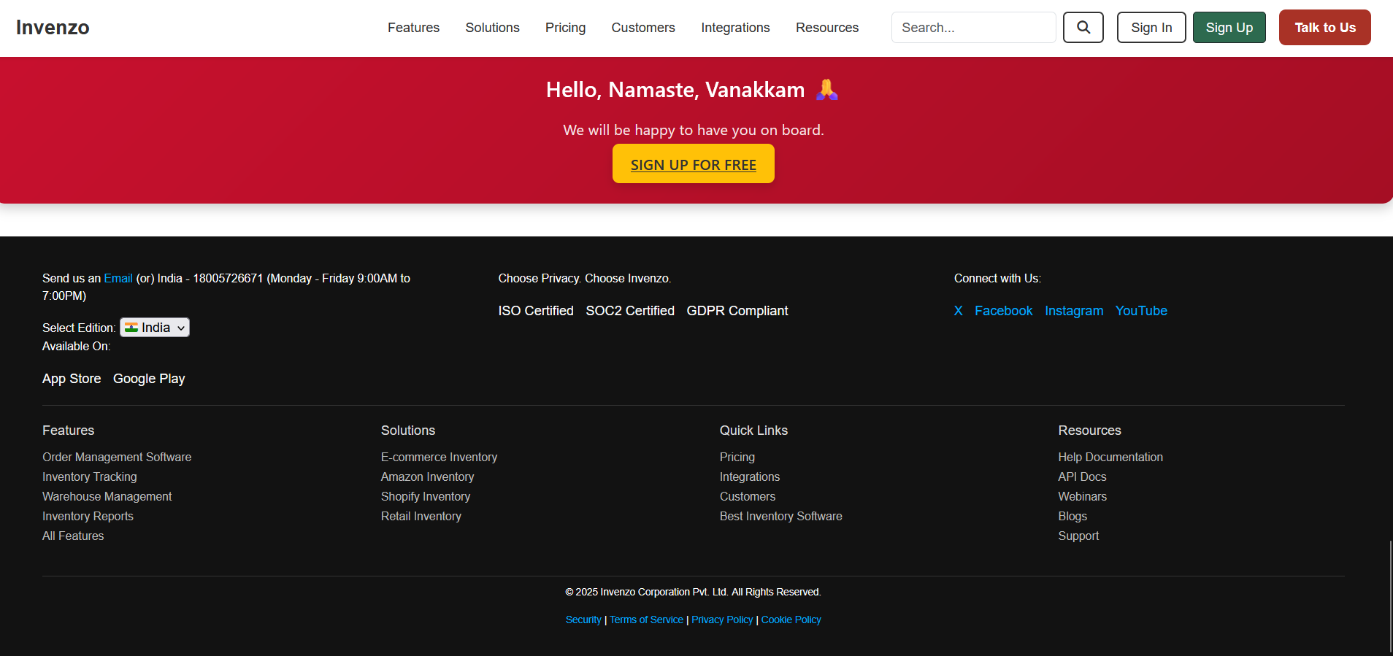
Project Highlights

Slide 12
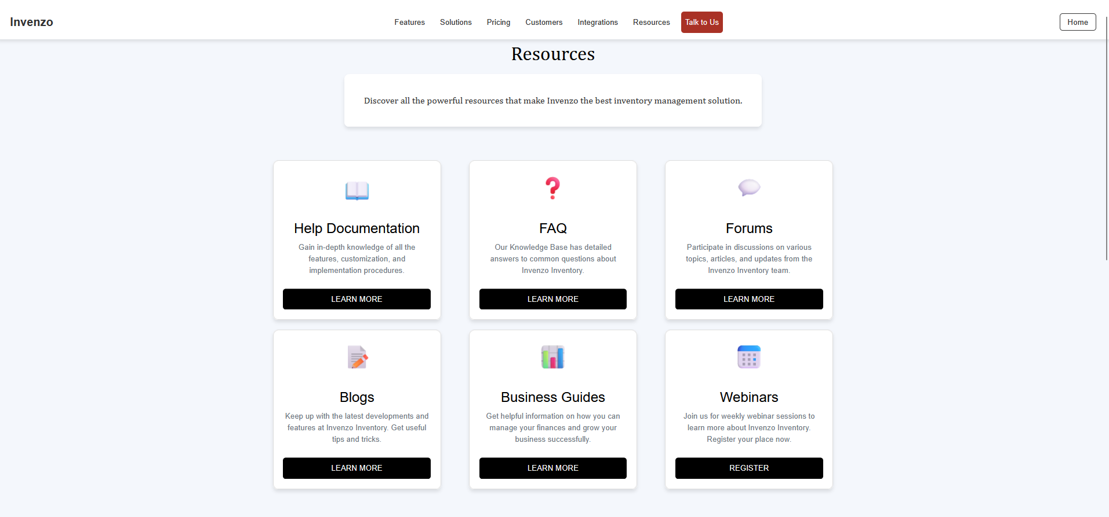
Project Highlights

Slide 13
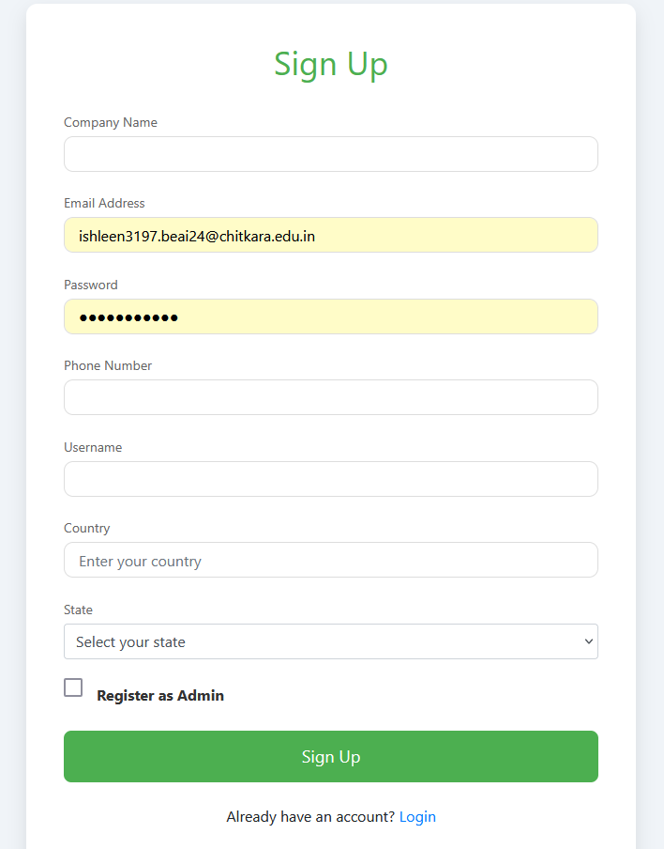
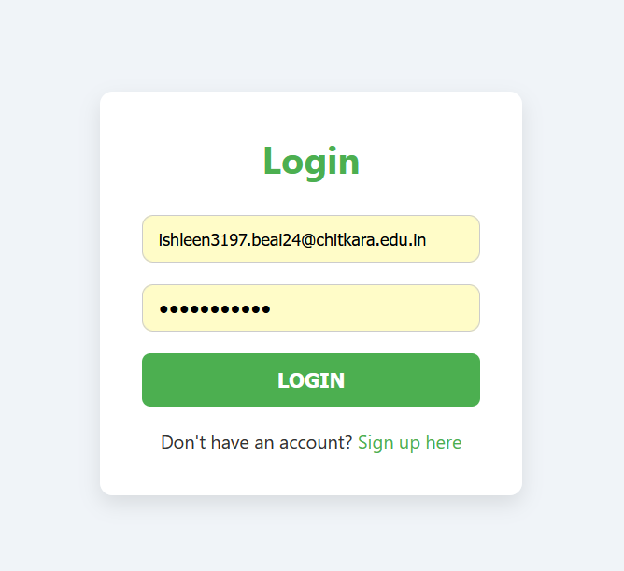
Project Highlights

Slide 14
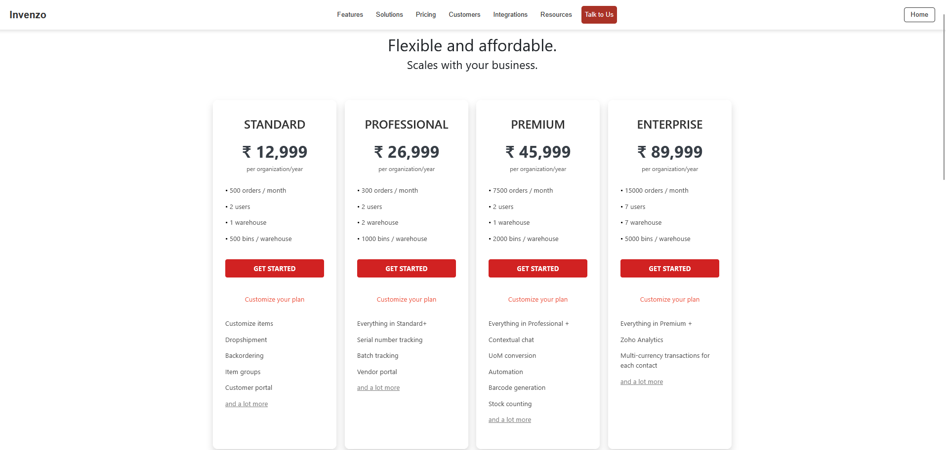
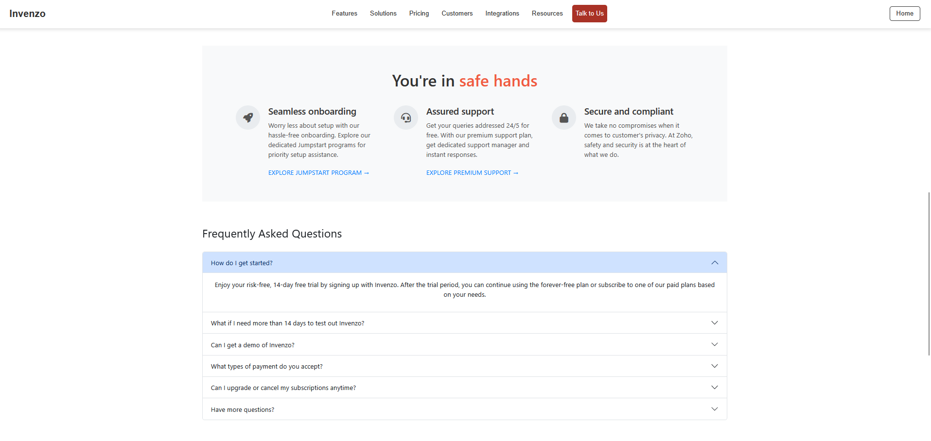
Project Highlights

Slide 15
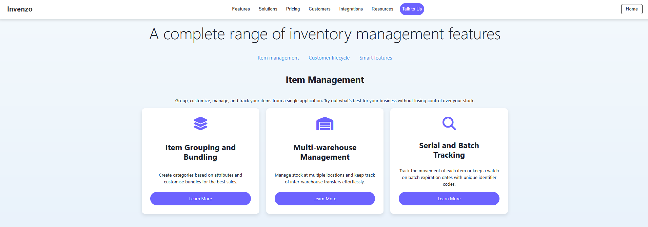
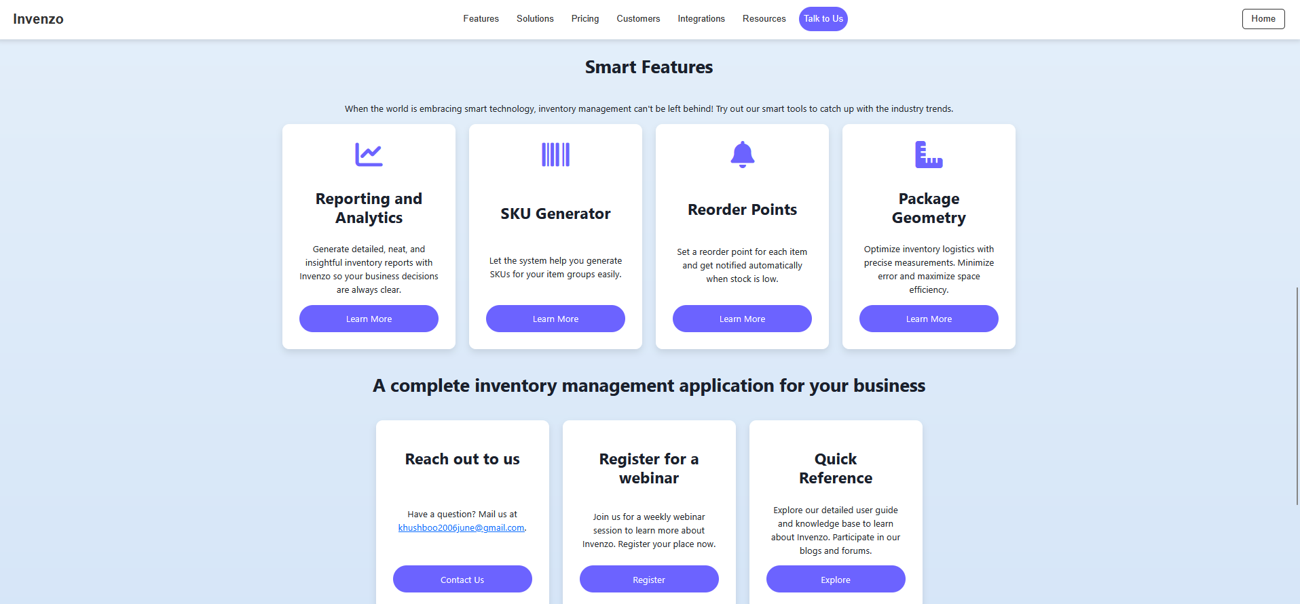
Project Highlights

Slide 16
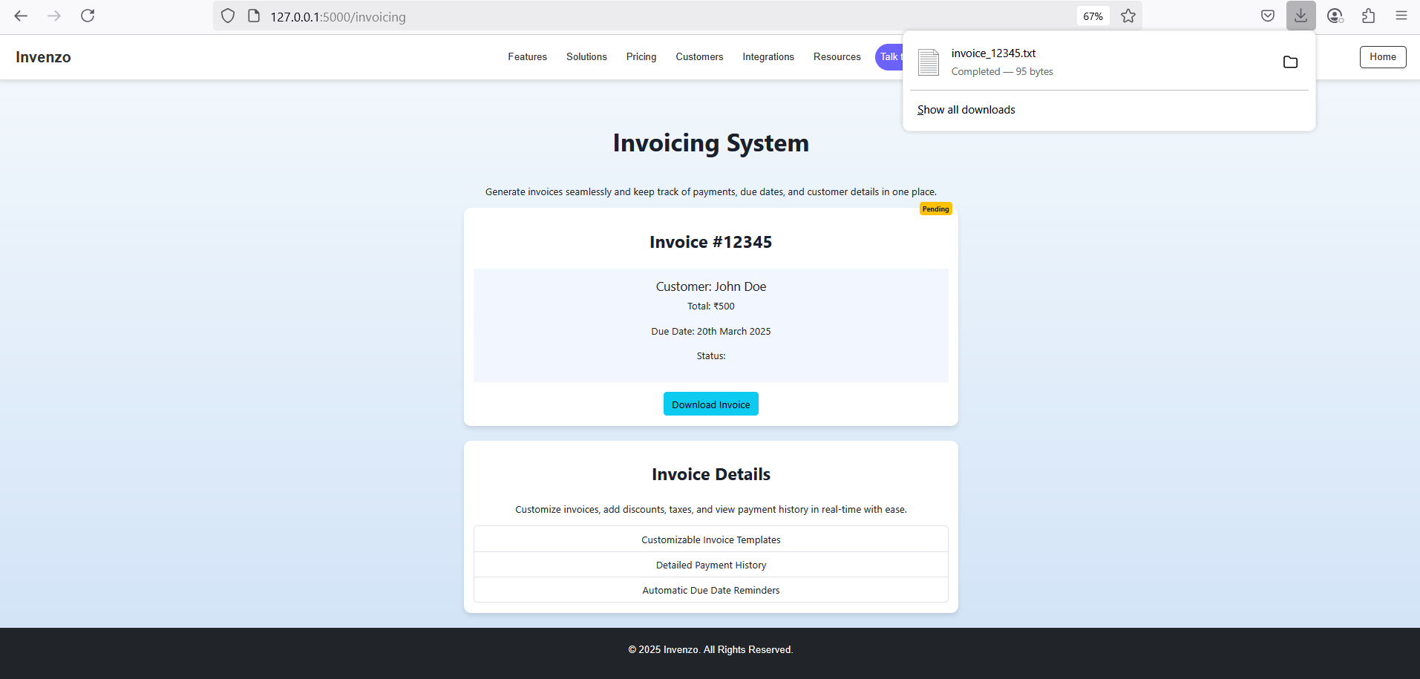
Project Highlights

Slide 17
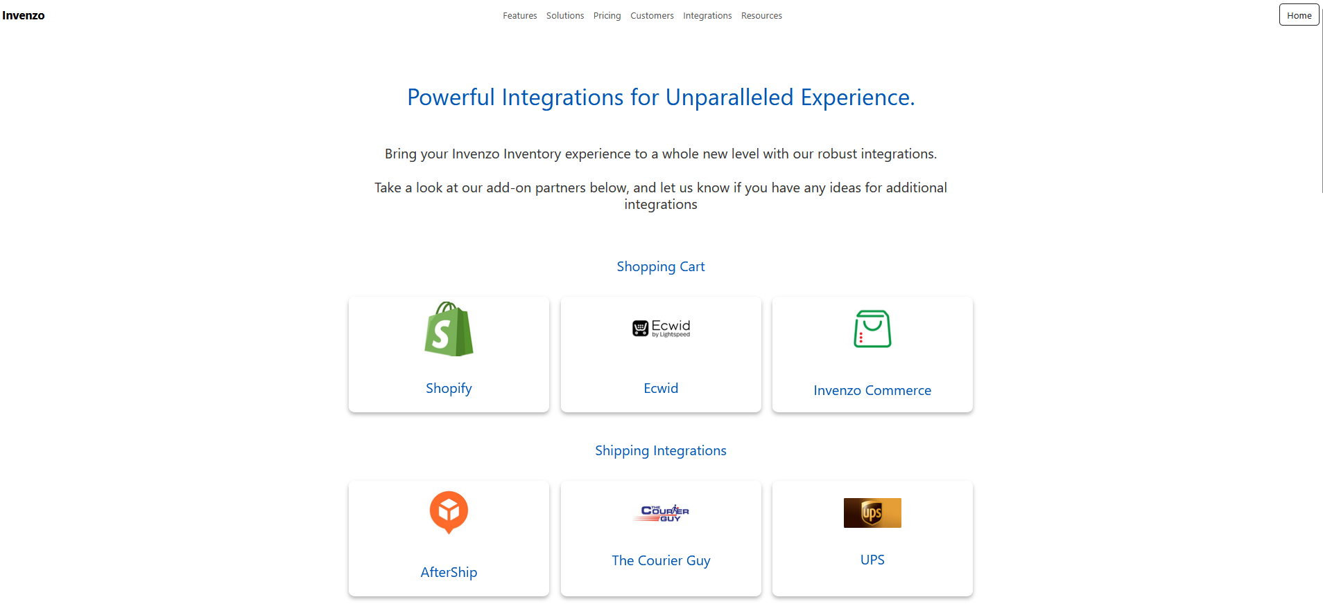
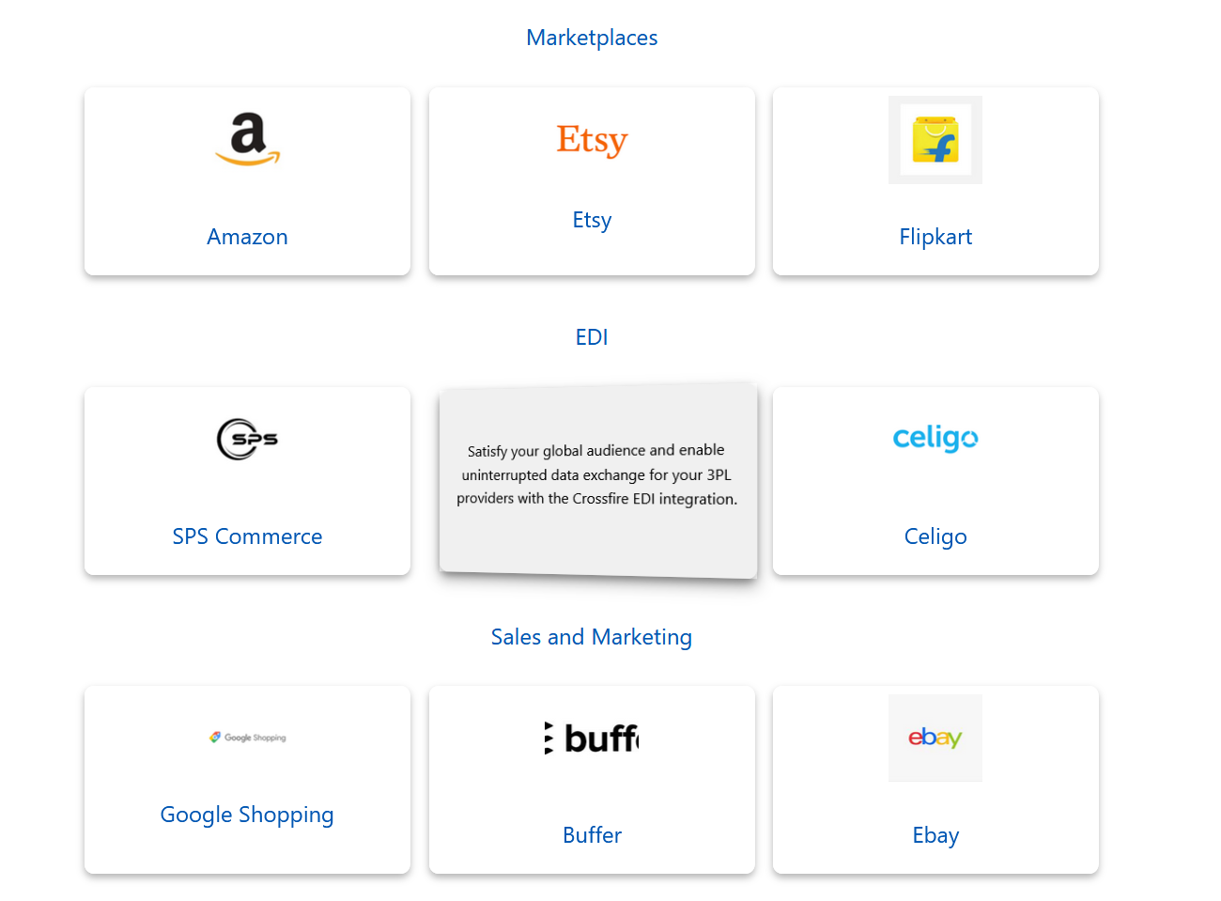
Project Highlights

Slide 18
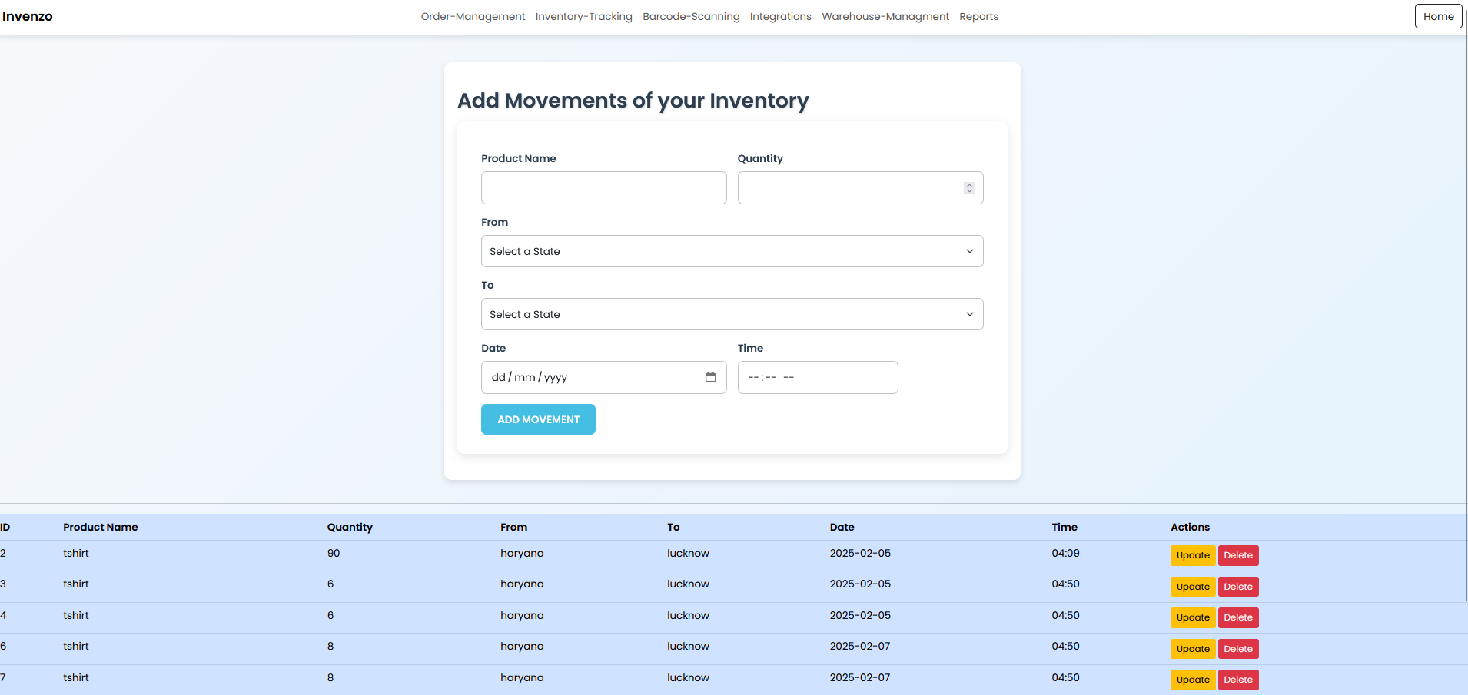
Project Highlights

Slide 19
Conclusion
Here’s the conclusion of an Inventory Management System :-
Improves Efficiency: Automates key tasks like stock tracking, reordering, and reporting, saving time and reducing errors.
Reduces Costs: Prevents stockouts and overstocking, helping businesses minimize waste and storage costs.
Enhances Decision-Making: Provides real-time data and detailed reports for informed decision-making.
Streamlines Operations: Facilitates smooth inventory management across multiple locations and integrates with other business systems.
Boosts Customer Satisfaction: Ensures timely product availability and accurate order fulfillment, improving customer experience.

Slide 20
References/Links used
References used in the project are:-
Sir Pavan Ambulkar’s provided course notes
W3Schools website
Several YouTube channels like:-
CodeWithHarry
ApnaCollege

Slide 21


